Slide 1
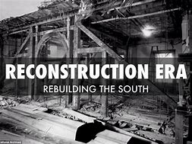
12.2 & 12.3
Reconstruction Issues & End of Reconstruction

Slide 2
Reconstruction state constitutions mandated the creation of the public school system.
Public schools grew slowly in the South.
The system was expensive as there needed to be two schools in every district due to segregation.
Some Republicans proposed integration but the idea was generally unpopular.
Notes:
2

Slide 3
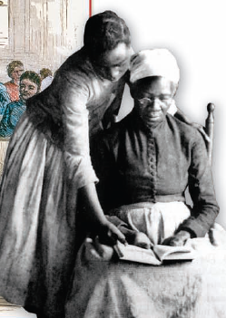
Reconstruction also offered white and black women opportunities they did not find in the North.
Single women carved out new roles for themselves, especially in the school system developed during Reconstruction.

Slide 4
The South had many problems
that made success challenging.
many illiterate southerners
poor quality medical care
poor quality housing
slower economic production than the North
limited protection for African Americans
racial violence
rampant corruption

Slide 5


Congressional passing and use of the
Enforcement Acts reduced racial violence.
The acts made it federal crime to interfere with a citizen’s right to vote.
Congress used the Enforcement Acts to indict Klansmen throughout the South.
Although violence declined, racial hatred persisted.
The
Enforcement Acts,
1870, 1871
Notes:
5

Slide 6

How and why did Reconstruction end?
Corruption throughout the North and South became a more pressing issue.
A financial collapse and the North’s unwillingness to maintain an eternal presence in the South eroded the reach of Reconstruction.

Slide 7
End of Reconstruction (Continued)
A series of Supreme Court decisions gave the federal government less control over the South and ate away at the few protections African Americans had gained.

Slide 8
Changes Brought By Reconstruction
For everyone:
tax-supported school system
modernized railroads
increased variety of the South’s crops
For African Americans:
gave African Americans some opportunities
reunited black families
provided educational opportunities
For women:
no voting rights
more economic opportunities

Slide 9
The Civil War had a lasting effect on
state and national politics.
Republican Party
Became known as the party of Lincoln
associated with freeing the slaves
became the party of big business
Democratic Party
became the party of industrial workers
associated with segregation in the South

Slide 10
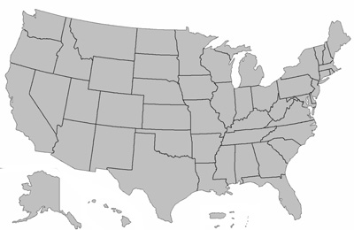
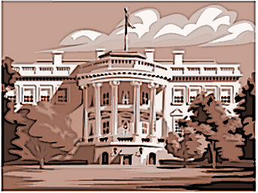
The Civil War affected the balance of power
between the federal government and the states.
Over time, Americans chose to let the South tend to its own affairs despite the price paid by newly freed slaves.
Notes:
10

Slide 11
Section 12.3 Review Questions
In what ways was the Grant Administration corrupt? (Pg. 419-420)
What are 3 reasons that the Reconstruction ended? (Pg. 421-422)
What were 2 lasting effects of the Reconstruction on African-Americans? (Pg. 425)
What was a lasting effect of the Reconstruction on women? (Pg. 425)
What effect(s) did the Reconstruction have on state and national politics? (Pg. 427)
What effect(s) did the Reconstruction have on state and federal power? (Pg. 427)

Slide 12
Vice President accused of stealing profits from railroads; he gave high-level positions to friends and acquaintances
Radical Republicans lost power; military expenses; Freedmen’s Bureau dissolve
14th Amendment (equal rights); 15th Amendment (male right to vote); land ownership; etc.
Suffrage movement began
Republicans became “party of Lincoln”, Democratic party became “big business party”
Balance of power

